Slide 1
Linking, Leveraging, and Partnerships to Grow Rural Communities
Heather Morgan
hmorgan@twsproject17.org
785-323-7001

Slide 2
All work is intertwined as basically illustrated below.
Economic Development
Education/Workforce
Health
Leadership
Promote Local Business
(Promote the Rural Opportunity Zone Program and assets of the region)
Promotion Region’s Quality of Life
(Involve youth in seeing the value of the region and staying in the region)
Improved “Soft Skills” of Workforce
(Circles Innovation)
Generational Poverty
(Strengthen Families! Circles- 10 percent of child out of poverty in 10 years. Workforce program)
Civic Team Leadership Training (Kansas Leadership Center)
(Increase leadership capacity across region)
Leadership connects with every initiative
Improve Broadband (Improve access, speed, and affordability to allow for business expansion and location of high tech businesses)
Increase Innovation
(Promote and support innovation in the region including fab labs and makers mindset)
Link Education to Business Needs
(Convening education and business to match needs)
Substance Abuse Prevention & Intervention
(Education and access to affordable treatment)
Youth Leadership
(Develop opportunities for youth to develop leadership skills and see the value of living in the region)
Increase & Support Entrepreneurship
(Ice House Entrepreneurship education and create entrepreneurship networks)
Regional Cooperative Marketing
(Pool resources promote the region)
Promote STEM Careers/Education
(Promote SB 155 credentials and STEM careers in region)
Preventative Health
(Increase physical activity and healthy food to create healthier communities and workforce)
Connecting Local Leadership Programs
(Network leaders across the region for a stronger SE KS)

Slide 3
Building Blocks of Community/Economic Development
Water
Waste Water
Electricity
Broadband
Roads
Housing
Child Care
Health Care
Entertainment
Recreation
Food Access
Birth-12th Grade
Community College
Technical College
Universities
Local Civic Engagement
Local Leadership
Statewide Leadership
Statues & Regulations
Local Ordinances
Local Policies

Slide 4
Keys to Success to allow rural regions to compete
Assets Linked and Leveraged - Region’s, partners’ & communities collective strengths
Data Driven – Build on innovation analytics work
Strategic Doing over Strategic Plans Preferred – What can we do?
Boundaries Spanned – Builds on interdependencies and diversity
Entrepreneur Focused – Support the private business risk takers
Innovation Based – Leap the competition
Needs and Competencies Clustered - Not just industries
Individuals Empowered – Rebuild an ownership culture
Nimble and Responsive – Not limited by bureaucratic boundaries and local politics

Slide 6
Good Rural Economic Development MUST look like this---

Slide 7
Rural Opportunities/Challenges and Successes
Broadband Access
Accessible, Affordable, and at the speed the community needs
Kansas has some of the best rural broadband in the country…rural broadband isn’t a problem everywhere but where it is a problem the problem is severe.
Complex problem that is often generalized and simplified. Solutions will be community specific and one-size fits all approaches wont work.
Be careful when you hear about additional federal funding for broadband to learn if it requires no coverage now. Many places in Kansas have bad service that is just a bit better than federal funds can be used for.
Our approach- two pilot projects to find the difference in cost between the return on investment the company needs and the cost to build. Once the difference is known then you can devise an action plan.
Unserved or underserved groups of citizens ban together and communicate to find out the cost to build to get to an acceptable return for the company as a first step. If company wont cooperate look into cooperative and other models.

Slide 8
Rural Health
Communicate early about an financial concerns with hospitals, pharmacies, clinics, transportation providers
Involve the community in the discussion where possible. More minds will create better solutions
Work with partners who may be able to help fill the gap or stabilize services
Don’t forget about mental health, specialty care, and transportation if it can’t be delivered in the rural community.
Look at Community Health Center of Southeast Kansas as an example for rural innovation and how they have expanded their reach.

Slide 9
Recruitment and Retention of People
Must have quality affordable housing and housing in various price ranges
Must have jobs that are paying fairly for the job and education required.
Must have some quality of life amenities and a community of people whom can form a social circle. People want different things. Play to your strengths, be creative, and not every improvement has to be costly.
Recruit like you are recruiting an athlete. Know what people want, their goals, their interests, their past. Showcase your community to them.
High Speed internet allows telecommuting. Make sure the service can sustain a trailing spouses tele-commute or they won’t stay.
Set the narrative when kids are young. Make sure you are positive and education system is connecting to local jobs.
Young people will move home if they have a place to live, good paying job, available childcare, feel welcome, have good schools, and some amenities. They will also become community leaders.
Examples of success- Kearney County Hospital, Greeley County, Allen County, Humboldt.
Local investment in funds to help with the move.

Slide 10
Market your strengths
Quality of Life
Contest for what kids would promote about their community/region.
Lucky Horseshoe 4-H Club and Eureka High School won contest for promoting rural Southeast Kansas
Trails
Flint Hills Nature Trail in Ottawa connected to the Prairie Spirit Trail down into Allen County
Dirty Kanza in the Flint Hills
Open Gravel Race in Barber and Pratt County
Recent ABC Trail Coalition connecting the trails in Allen, Bourbon, and Crawford Counties

Slide 11
Myths and Missteps
Hiring someone to “focus” solely on your community will yield results
They must travel to shows and be chasing the next big thing
Not understanding your true assets
Not understanding an asset isn’t an asset if ten other communities have the same thing
WORKFORCE is the number one driver for nearly every business.
Thinking workforce can be addressed easily if there is a shortage
Thinking anyone can come in and build relationship
Thinking local politics don’t matter
Thinking social networks don’t matter
That an economic development professional will just “know” what do to
Assuming people like something because that’s the way its always been
Assuming the community doesn’t need to buy in and have had a voice in the process about the vision for the economic future of the county
Someone you hire will care as much about the community as you do
Thinking that the community won’t step up to assist in economic development if asked
Thinking if you build it they will come vs. being shovel ready
Thinking you shouldn’t have an idea of a local incentive package
Thinking you should sell the business on your community before listening to what the business needs

Slide 12
Lessons Learned
Bottom up approach is a must.
Don’t waste time with dysfunctional organizations or people.
Whatever your scope of work is it will change. You have to go where the community energy is.
Unusual suspects are your most valuable contributors.
There will be skeptics, be prepared with answers.
Engagement will be slow until visual success is seen.
The community isn’t always ready for “academic” and “best practice” use the practice not the words ☺.
LEADERSHIP TRAINING IS CRITICAL.
Traditional hierarchical command and control structures are woefully ineffective to address socially complex, wicked problems – need a holistic approach toward economic growth
Need network weavers who are purposeful connectors and boundary spanners equipped with connections and data/information
Need to be organic, responsive, agile, and continuously experimental.
Requires new ways of thinking, behaving and doing.

Slide 13
Ideas to help rural Kansas-
Spur Kansas Growth Act
Help draft bill to reinstate the Sales Tax Part of the old enterprise zone program that allows rural communities to take advantage of sale tax advantages like bigger places can using Industrial Revenue Bonds
Will be small fiscal note but only one time sales tax loss for property that will be on the tax rolls going forward or create jobs which will generate revenue for state and local government
Support the Department of Commerce
They are critical to trying to help local businesses expand or attract local businesses even if the business receives no Department of Commerce incentives.
Rural Sized Deal Closing Fund
Help suggest new incentives that would be better sized for smaller rural companies. If 5-10 good paying jobs are created in rural community that has the impact of 100’s in an urban area. Also make sure the incentive isn’t restricted to certain NAICS codes
No One Size Fits All Approaches
Resist trying to revitalize with one size fits all approaches. Each region of the state, each rural community, and each industry has different needs. The challenges facing rural communities are multi-faceted and complex. A flexible solution will be needed to the many adaptive problems facing rural Kansas

Slide 14
The Advanced Manufacturing Institutes Rural Economic and Community Development Work
In addition to Project 17
Direct assistance for rural Kansas companies for product innovation, development, patent searches, and technology improvement.
Serving many rural Kansas businesses.
Websites, Logos, E-Commerce for rural businesses
Statewide rural businesses.
Local Food Promotion in 17 counties in Southeast Kansas
Contract Economic Development Work with rural communities
Rural Community Facility Technical Assistance- Assistance to rural communities in planning, budgeting, application for USDA-RD loans/grants, coalition building, strategic doing.
Pratt, Dighton, Frankfort, Caney, Yates Center, Meade, Fowler, Fort Scott, Ottawa, Concordia, Clay Center, Belle Plaine, Council Grove….any many more…..

Slide 15
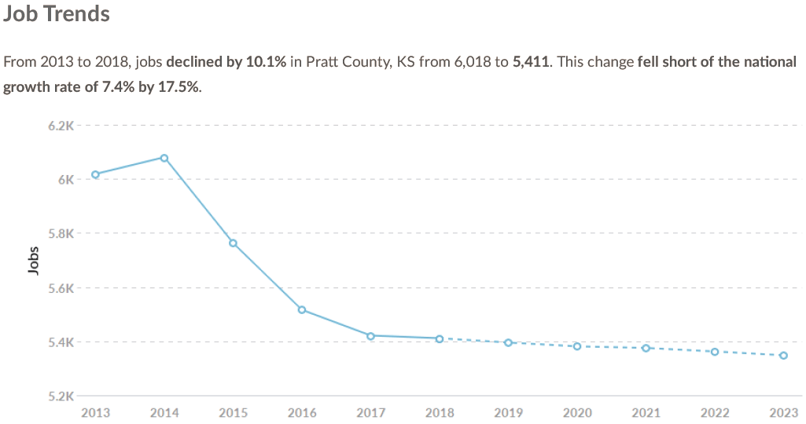
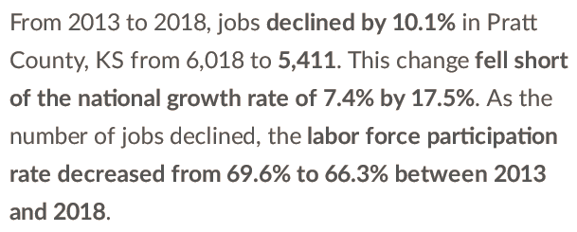
Pratt County

Slide 16
Pratt County Statistics
Pratt County
KC Area*
*KC Area- Johnson, Wyandotte, Leavenworth, Miami in Kansas and Cass, Clay, Jackson, Ray, Platte.

Slide 17
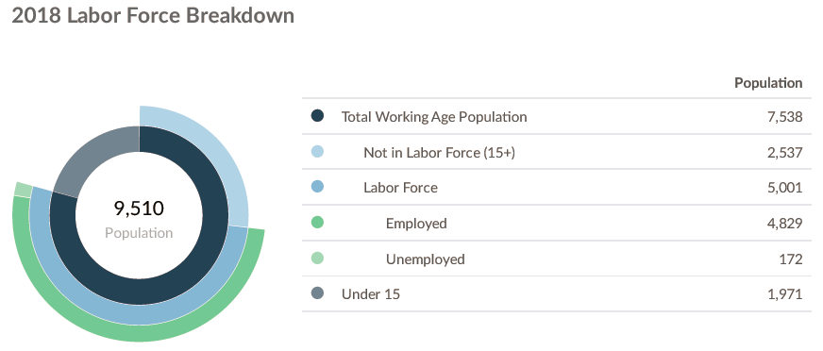
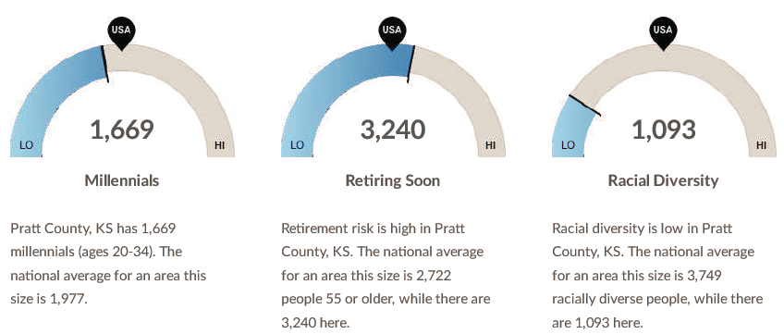
Pratt County Labor Force Characteristics
*119 unemployed according to KS DOL reports
Pratt County Characteristics

Slide 18
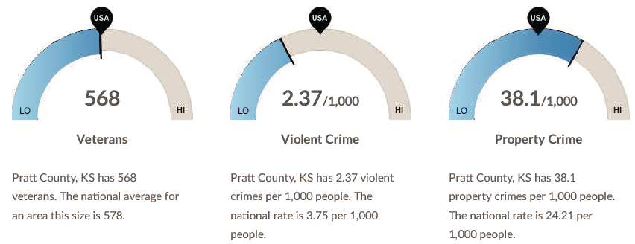
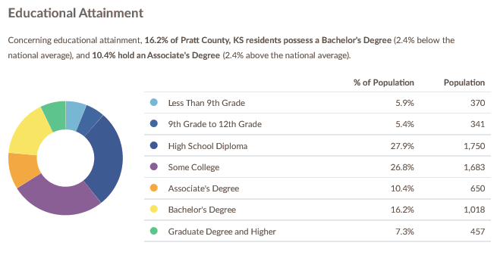
Pratt County Crime and Educational Characteristics

Slide 19
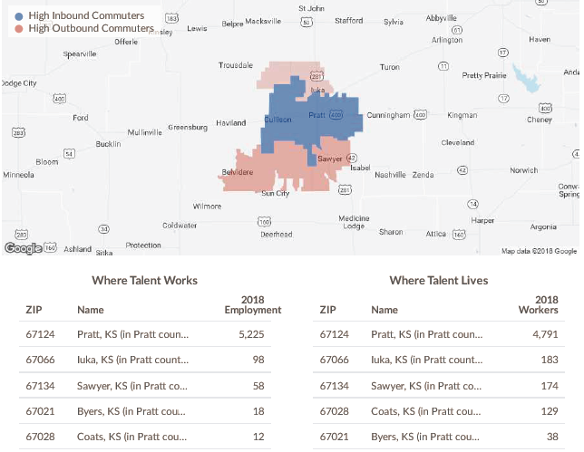

Slide 20
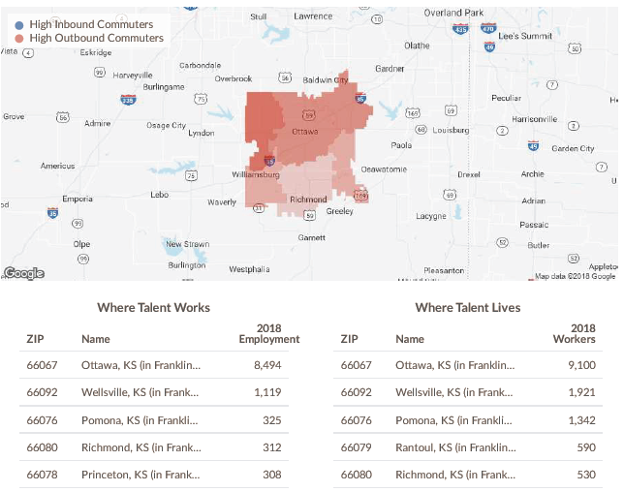

Slide 21
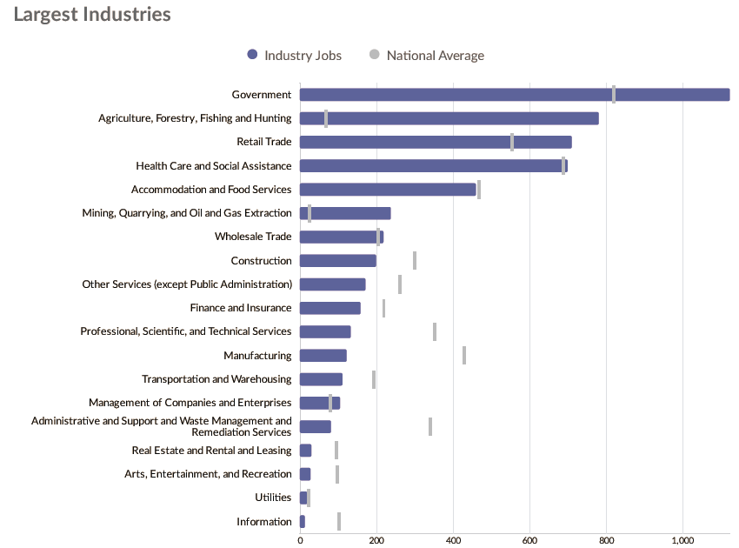
Pratt County

Slide 22
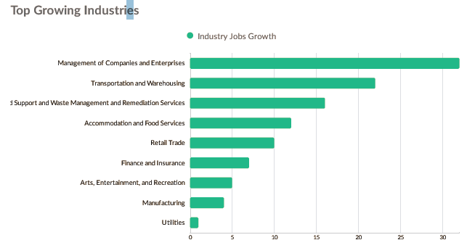
Pratt County

Slide 23
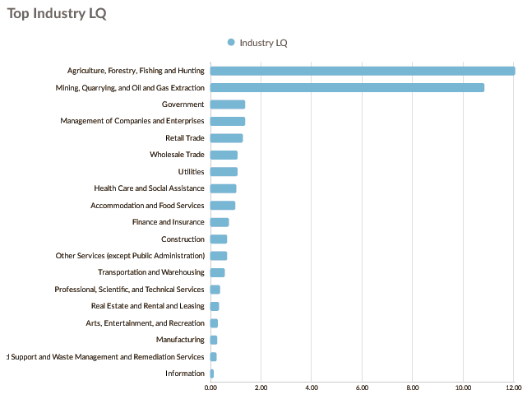
Pratt County

Slide 24
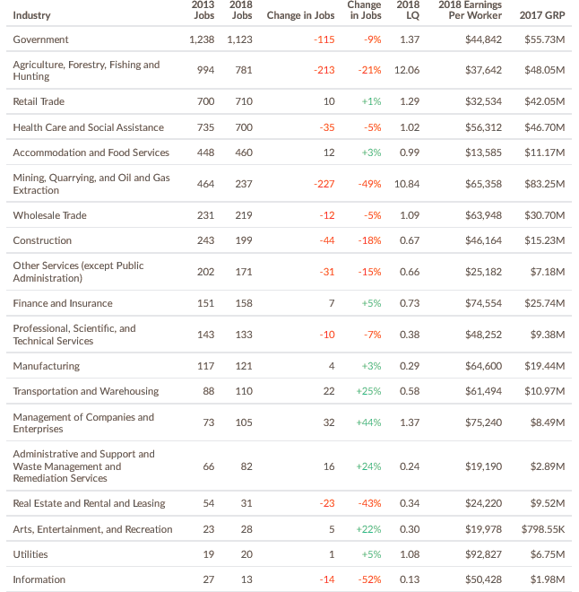
Pratt County

Slide 25
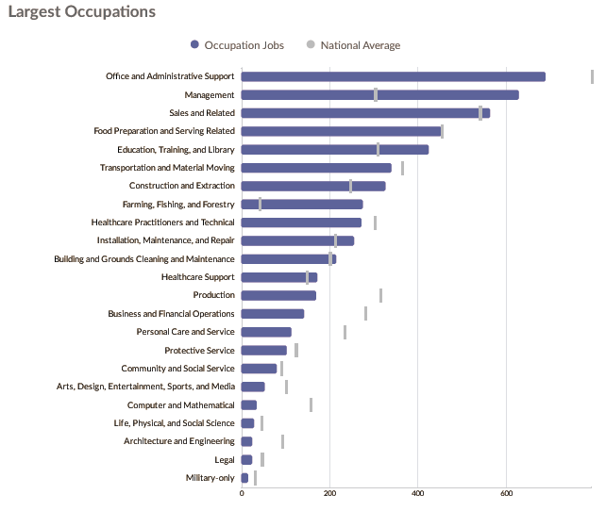
Pratt County

Slide 26
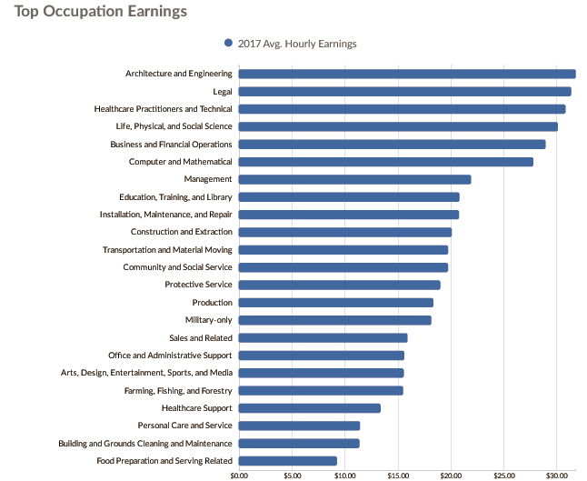
Pratt County

Slide 27
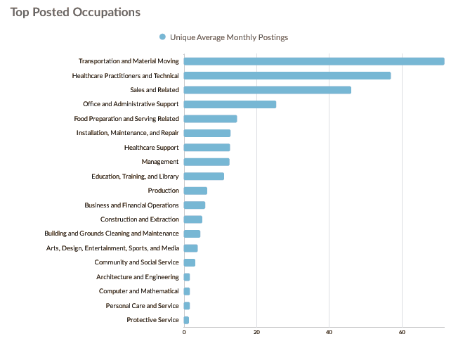
Pratt County

Slide 28
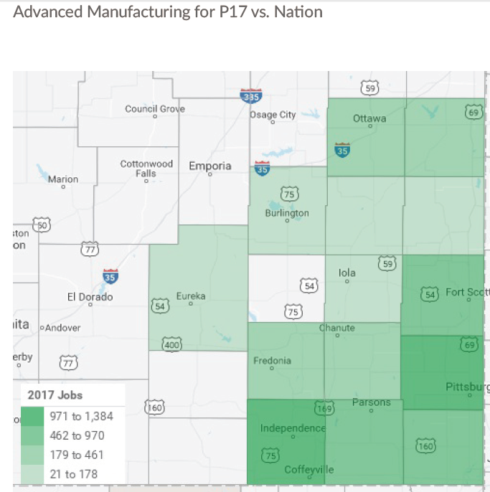

Slide 29
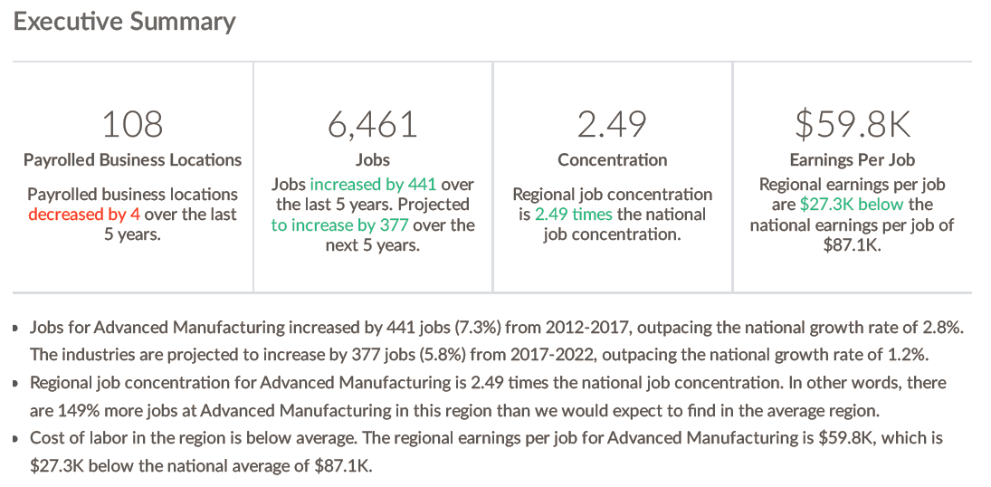
Advanced Manufacturing

Slide 30
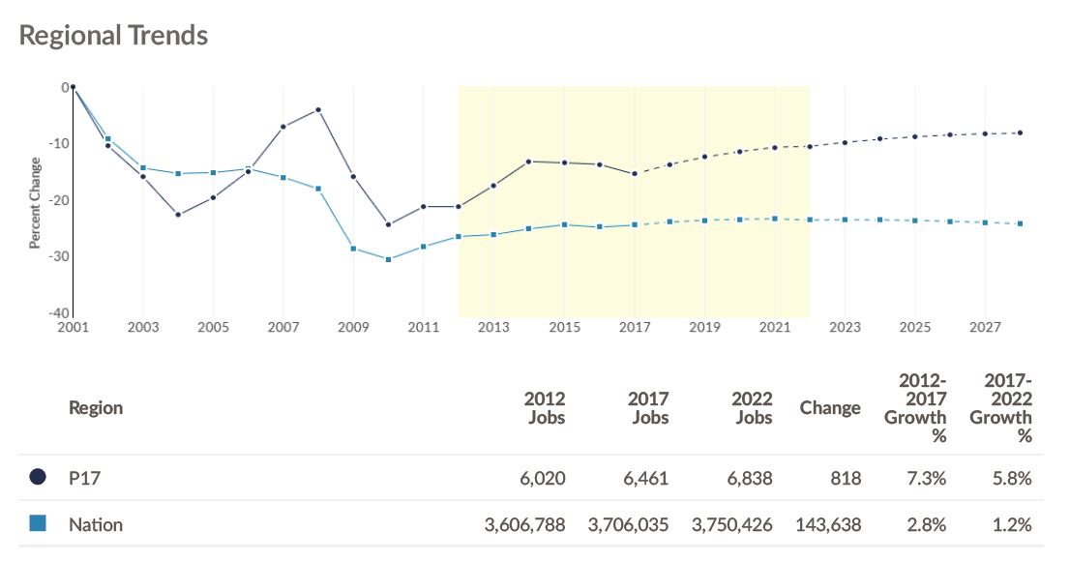
Advanced Manufacturing

Slide 31
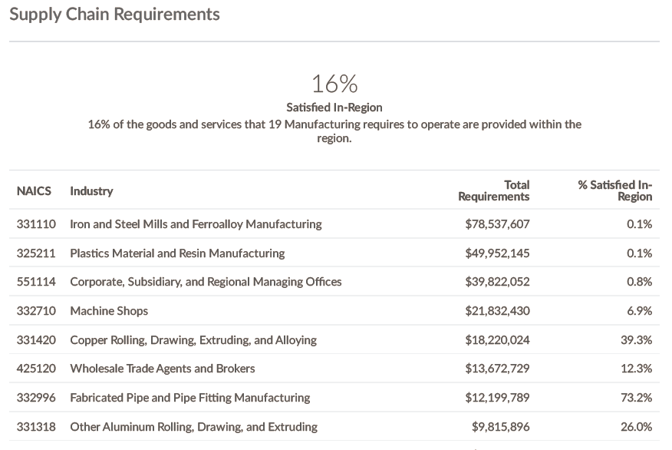
Advanced Manufacturing

Slide 32
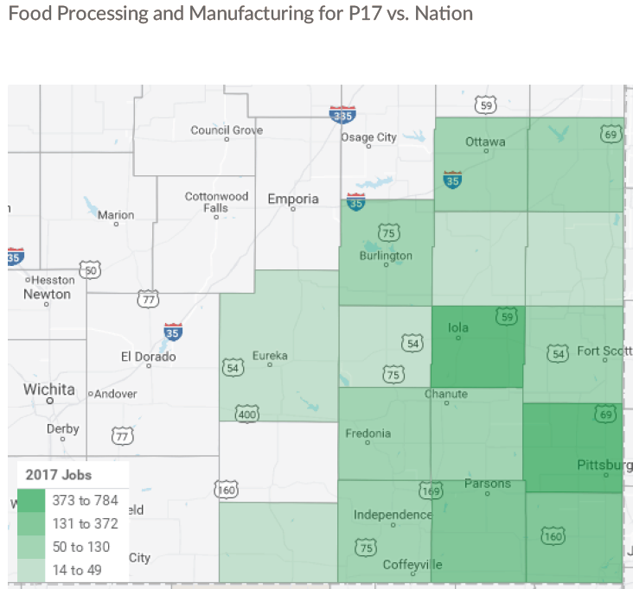

Slide 33
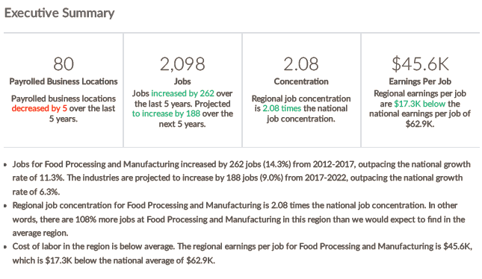
Food Manufacturing and Processing

Slide 34
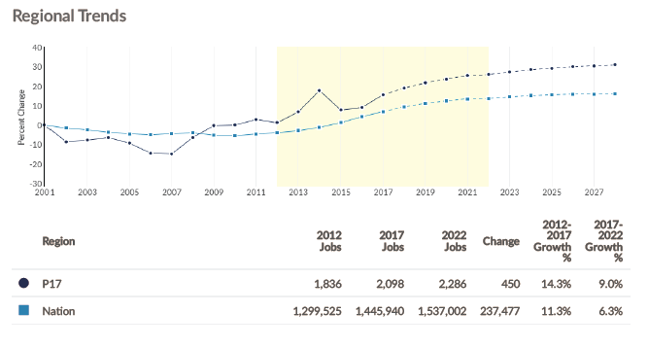
Food Manufacturing and Processing

Slide 35
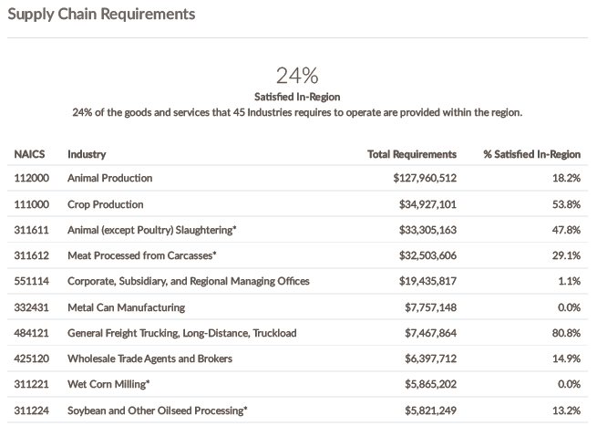
Food Manufacturing and Processing

