Slide 1
The HR Knot: Recruitment & Selection
Presented by Jon Thummel
Director of Geary County Human Resources

Slide 2
Job Descriptions
The key to the whole employment process
Only BFOQs
Elements
Description of the Job
KSAs
Physical Requirements
Minimum Qualifications

Slide 5
Minimum Qualifications
MINIMUM QUALIFICATIONS
High School diploma or GED equivalent.
Two (2) years of experience working in customer service and accountable for money, preferably in an office setting.
Must attain certification in MoVRS System within six months of employment.
One (1) year of experience in Microsoft Office or other similar software required.

Slide 6
Develop Recruitment Strategy
THINGS TO CONSIDER:
Budget
Advertising: When and Where
KAC Newsletter
Publications
Newspaper
Job Boards
Social Media
Using a Search Firm
Timeline
Job Fairs

Slide 7
Collection & Processing of Applications
Websites
Paper Applications
Resumes only

Slide 8
Assessing Qualifications of Applicants
Who will assess the qualifications?
Recommend one person for consistency.
Hard or technical jobs.
Testing

Slide 9
Assessment Exercise #1
MINIMUM QUALIFICATIONS
High School diploma or GED equivalent.
Two (2) years of experience working in customer service and accountable for money, preferably in an office setting.
Must attain certification in MoVRS System within six months of employment.
One (1) year of experience in Microsoft Office or other similar software required.

Slide 10
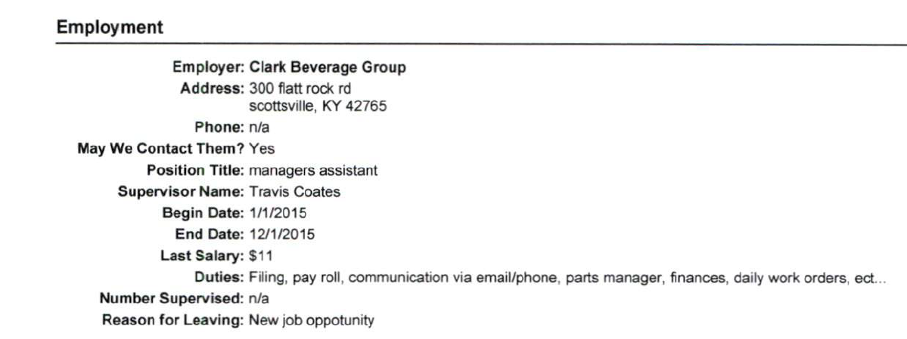
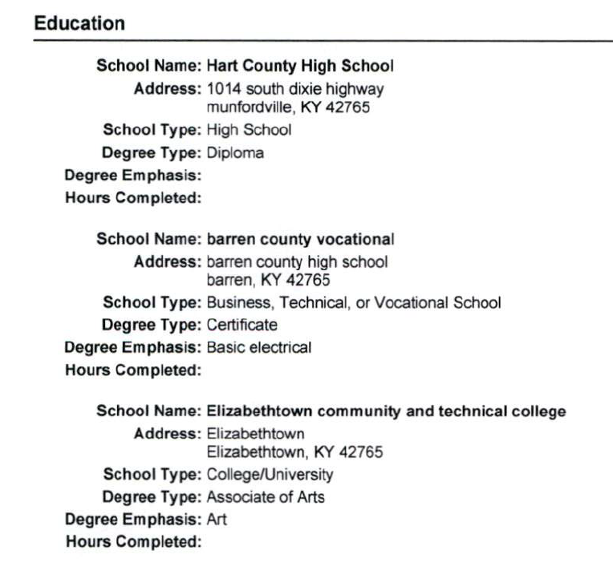

Slide 11
Assessment Exercise #2
MINIMUM QUALIFICATIONS
High School diploma or GED equivalent.
Two (2) years of experience working in customer service and accountable for money, preferably in an office setting.
Must attain certification in MoVRS System within six months of employment.
One (1) year of experience in Microsoft Office or other similar software required.

Slide 12
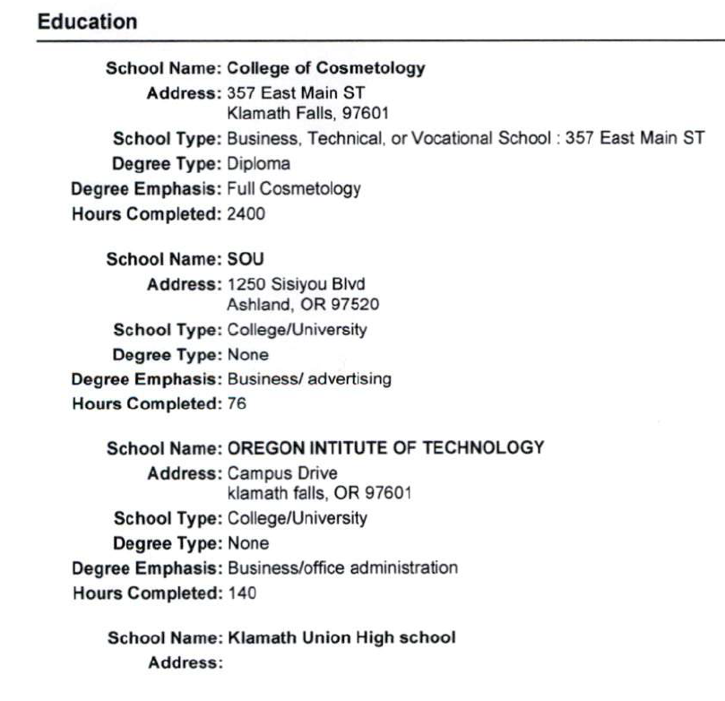

Slide 13
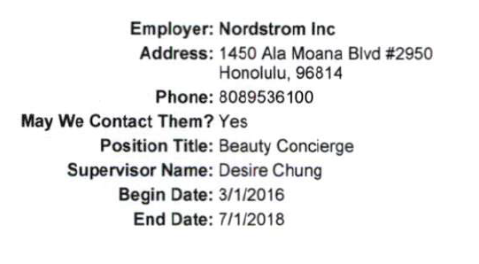

Slide 14
Assessment Exercise #3
MINIMUM QUALIFICATIONS
High School diploma or GED equivalent.
Two (2) years of experience working in customer service and accountable for money, preferably in an office setting.
Must attain certification in MoVRS System within six months of employment.
One (1) year of experience in Microsoft Office or other similar software required.

Slide 15
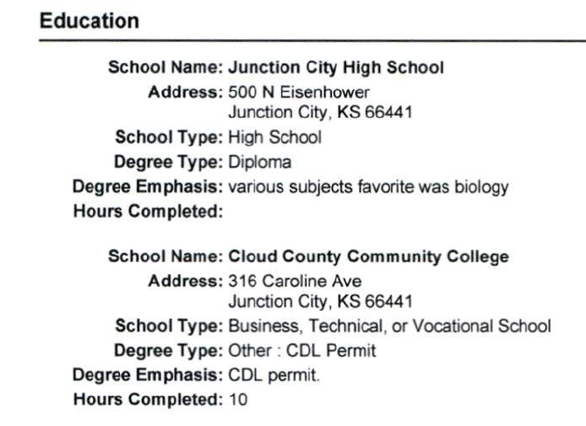
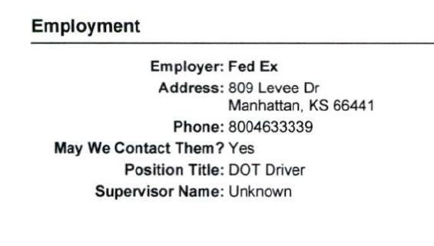
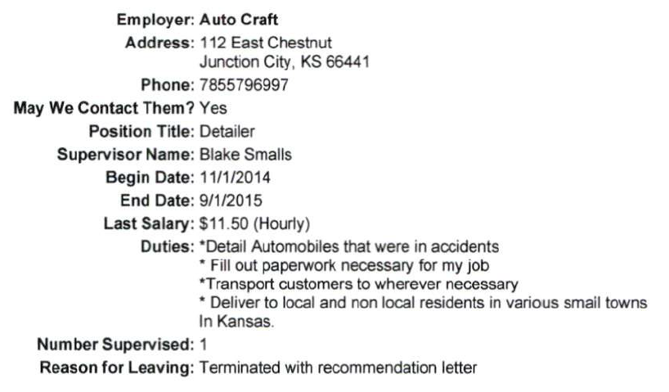
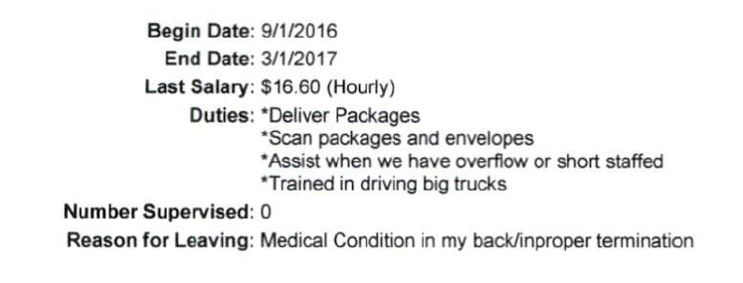
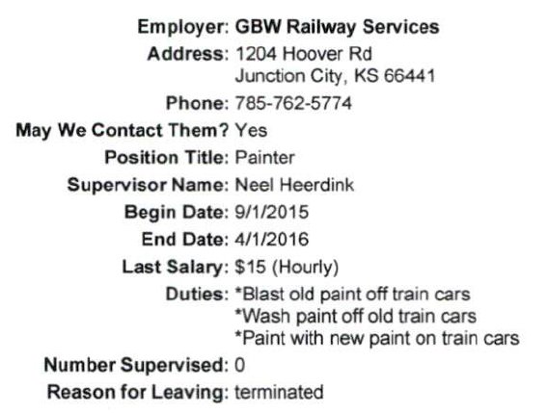
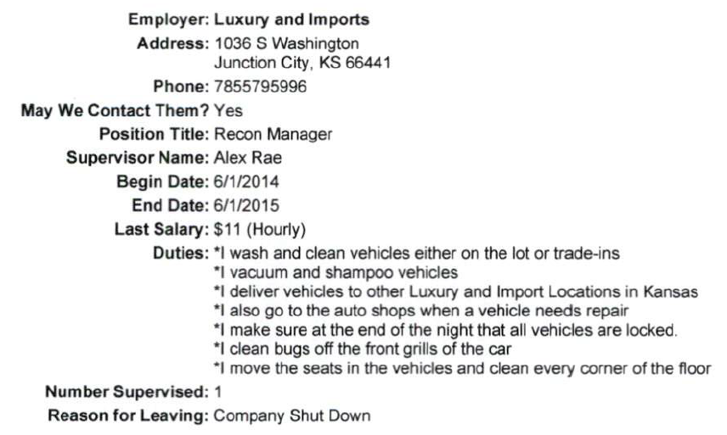

Slide 16
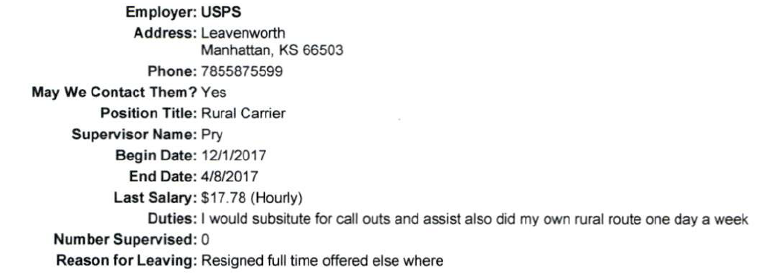

Slide 17
Assessment Exercise #4
MINIMUM QUALIFICATIONS
High School diploma or GED equivalent.
Two (2) years of experience working in customer service and accountable for money, preferably in an office setting.
Must attain certification in MoVRS System within six months of employment.
One (1) year of experience in Microsoft Office or other similar software required.

Slide 18
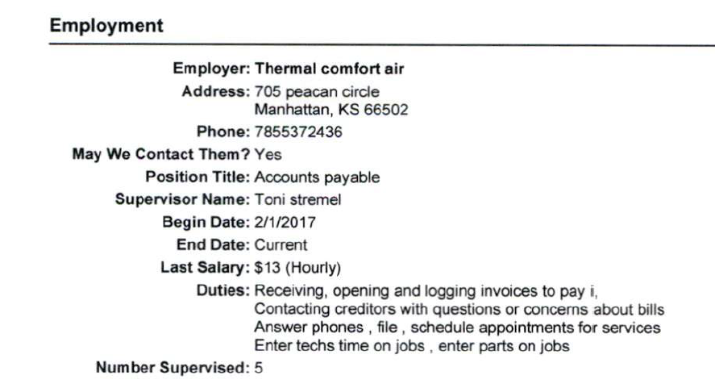
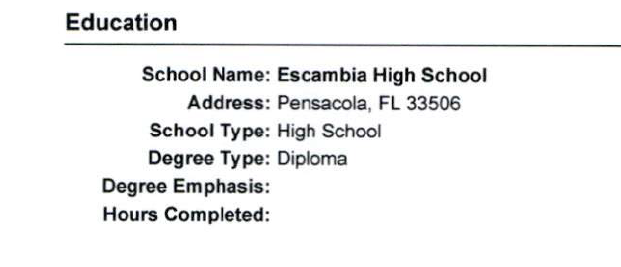

Slide 19
Interviews
Finally, the fun? part!

Slide 20
Preparation is the key!
Who will interview
Supervisor
Human Resources
Community members
Technical Advisors
Peers
Questions
Scoring

Slide 21
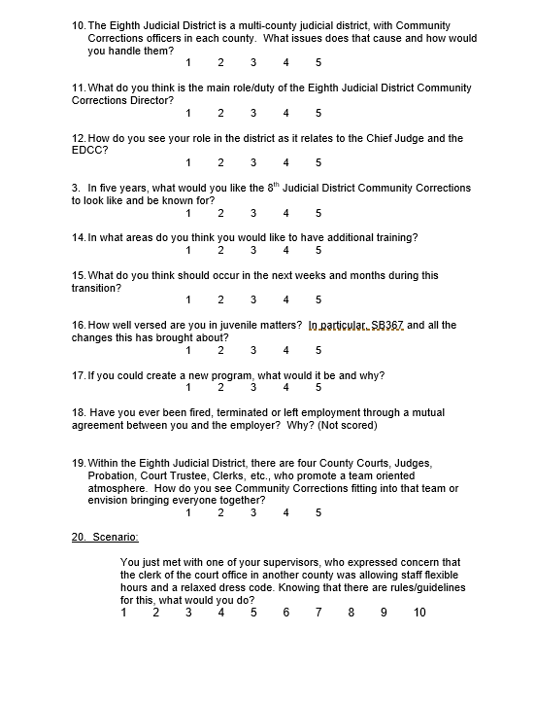
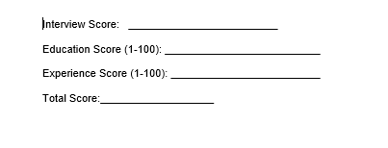
Interview Form & Questions

Slide 22
More About Questions
Title VII
ADA
The WORST question to ask to build rapport!
Tell me about yourself.
I am a life-long Kansan who grew up on the family farm in Jewell County. After high school I attended Kansas State University where I obtained a Bachelor’s degree in Political Science and a Master’s degree in Public Administration with an emphasis in Public Personnel Administration. I have worked in all three sectors: not-for-profit, for profit and government. I have over 20 years of experience working in government mostly at the county level. I have a lovely wife, Karen, and three daughters, Heather, Jessica and Megan. I enjoy making hardwood furniture in my spare time. I am currently the Director of Human Resources for Geary County.

Slide 23
Other Illegal Questions
Do you own your own home or rent?
When did you graduate from high school?
Are you a U.S. citizen?
Have you ever suffered a workplace injury?
Where did you graduate from high school?
Are you married?
Are you pregnant?
Do you have children? Are you planning to have children?
How tall are you?
What sorority were you in?
Who is your pastor?
What gender do you identify as?

Slide 24
Holding the Interview
No more than 6 in a day; preference is 4.
Who will ask the questions?
Keep it all structured and moving along.
No side bar conversations between members.
Germane follow-up questions only.
Clarifications-more in depth

Slide 25
Ending the Interview
Don’t make promises!
Give a copy of benefits, if possible and needed.
Make sure you follow up with candidates.

Slide 26
Extending an Offer
Make sure they understand it is just an offer contingent upon passing all background checks.
Want to think about it or negotiate?
Keep time frames short.

Slide 27
Background Checks
All background checks are conducted post-offer.
Credit
Criminal
Transcripts
Drug screens
Reference check

Slide 28
Getting the Employee Started
Orientation (formal vs informal)
Remember to send your new hire’s name to the Kansas New Hire Directory (Deadbeat Parent’s List)

Slide 29
Laws that Impact Hiring
Title VII of the Civil Rights Act
Age Discrimination in Employment Act
Equal Pay Act
KPDA
ADA
FLSA
FMCSA

